Slide 1
PhysioNet Challenge – AF classification
Speaker: Yu-Cheng, Lin
Advisor:
Date: 2019/10/16

Slide 2
Outline
About center wave
DTW distance
Spectral clustering
Silhouette score
Discussion
Future work
Reference

Slide 3


About center wave
In paper 2:
1. Calculate pairwise DTW distance, due to uneven length
2. Group short waves by spectral clustering
3. Find the center node(no details) of the biggest cluster as center wave
In its code:
1. Calculate pairwise L2 distance by resampling to the same length
2. Sum all the distance for each waveform
3. Find the largest sum-L2-distance as center wave
Our method:
1. Calculate pairwise DTW distance
2. Group short waves by spectral clustering
3. Find the lowest silhouette scores of the biggest cluster as center wave

Slide 4
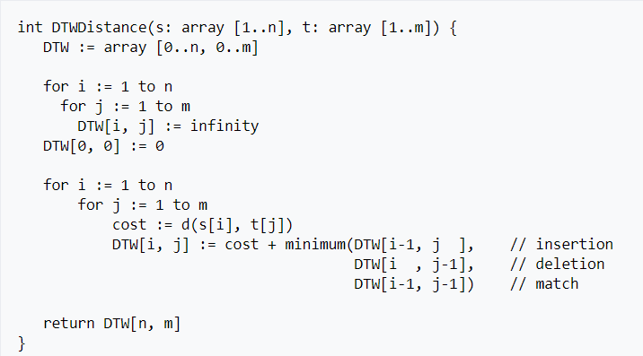
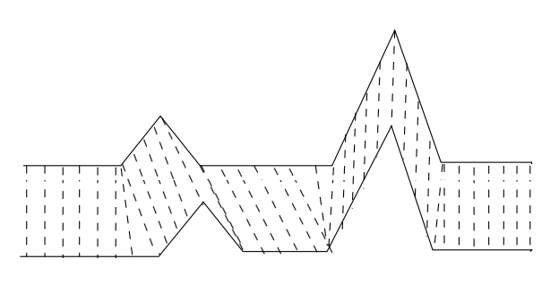
DTW distance(dynamic time warping)
A Dynamic-programming approach

Slide 5
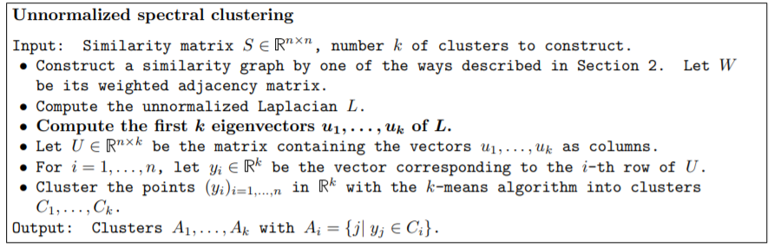
Spectral clustering

Slide 6
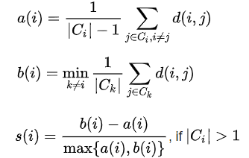
Silhouette score
Mentioned in paper 14

Slide 7
Discussion
How spectral clustering performs?
Hierarchical clustering(in paper 14) instead of Spectral clustering?
It takes a long time to get center wave(about 90 hours)
Get more center wave?
(From last time) reversal lead problem?

Slide 8
Future work
Training on center wave to get center wave features
Preprocessing long data and train it

Slide 9
Reference
DTW distance(https://en.wikipedia.org/wiki/Dynamic_time_warping)
A Tutorial on Spectral Clustering, Ulrike von Luxburg
Silhouette score(https://en.wikipedia.org/wiki/Silhouette_(clustering))

